Slide 1
Student Survey Feedback on Remote Learning

Slide 2
Student Survey January 2021
Thank you to everyone who took part in the survey.
We have used the information to help us develop / clarify what we are doing with remote learning.

Slide 3
You told us… Some people didn’t have a device to work on or were working on phones.
Our response…
We have provided Chromebooks to students who have told us they were struggling with home learning because of a lack of technology.
If this is a problem for you – let us know.

Slide 4
You told us… You wanted less screen time and would read if you had more time.
Our response…
We introduced DEAR (Drop Everything and Read) for years 7-10 to give you time to read for pleasure and to have a break from your screens.
Next DEAR is Tuesday 2nd February – periods 5 and 6!

Slide 5
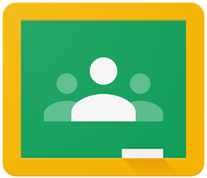
You told us… About your preferences for lessons and would like more interactive activities.
Our response…
Your teachers are working extremely hard to produce high quality lessons for you.
Everyday your teachers are learning new things and trying new technology to bring you the most engaging lessons they can under the current circumstances.

Slide 6
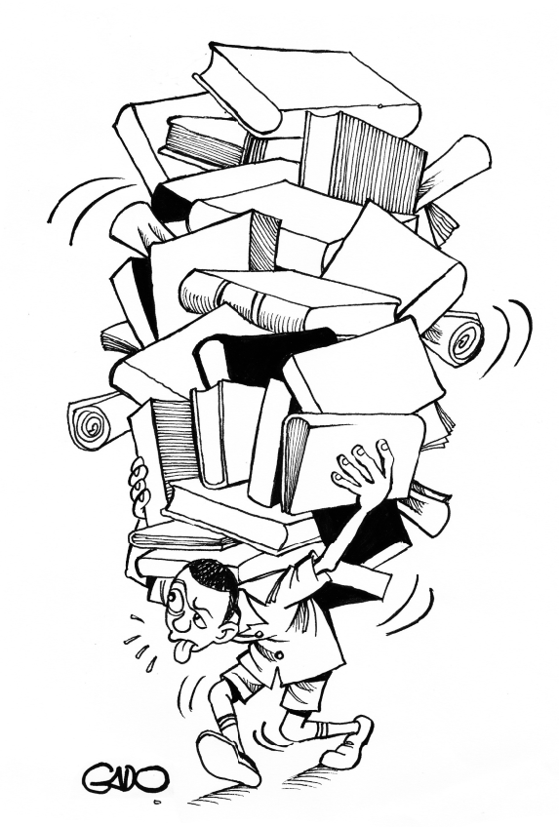
You told us… About your concerns regarding your workload and the deadlines.
Our response…
You should follow your timetable each day and complete the work set in the 40/50 minutes for your lesson. Ensure you complete the tasks to the best of your ability and submit what you have achieved in this time.
We do not expect you to work from 8.40am to 5pm each day. There is a 5pm deadline to allow you time to upload work etc. in case you have any difficulties doing this during the day.
Your concerns about having too much to do has been shared with your teachers. Please talk to your teachers if there is too much work for you to cope with.

Slide 7
You told us… About feeling stressed, your well-being and that you would like to interact more with each other.
Our response…
We are looking at ways to include more breaks away from your screens and for opportunities where you can feel part of the St. Mark’s community again.

Slide 8
You told us… THANK YOU for all of our hard work.
Our response…
Well done to everyone! We are so proud of you all. These are extremely difficult circumstances for everyone; the majority of St Mark’s students are working really well during remote learning. Thank you for appreciating the efforts of your teachers and keep up the great work!

